Slide 1
Unit 4

Slide 2
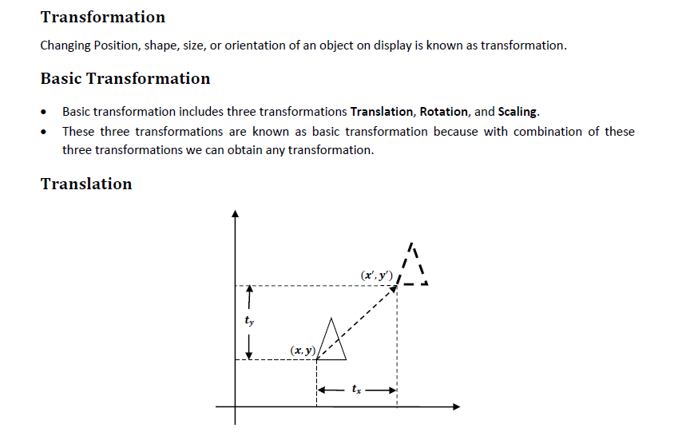

Slide 3
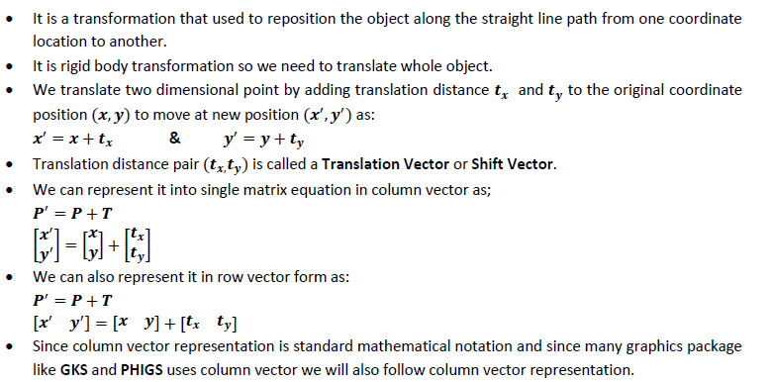

Slide 4
Short for Graphical Kernel System, GKS is an international standard for computer graphic files that define how graphics are handled by software.
This standardization allows for computer graphic files to be created on one computer and moved to a different computer or software program.

Slide 5
PHIGS (Programmer's Hierarchical Interactive Graphics System) is an application programming interface (API) standard for rendering 3D computer graphics.

Slide 6
Translation is a movement of objects without deformation. Every position or point is translated by the same amount.
When the straight line is translated, then it will be drawn using endpoints.
For translating polygon, each vertex of the polygon is converted to a new position.
Similarly, curved objects are translated. To change the position of the circle or ellipse its center coordinates are transformed, then the object is drawn using new coordinates.
Let P is a point with coordinates (x, y). It will be translated as (x1 y1).

Slide 7
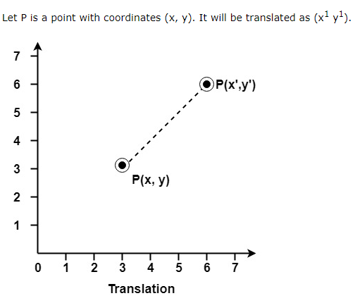

Slide 8
examples

Slide 9
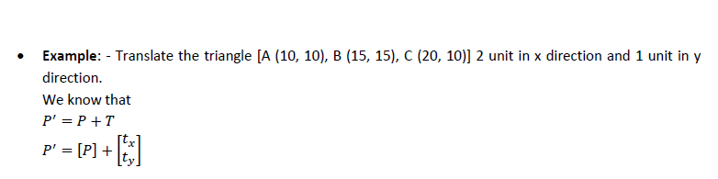

Slide 10
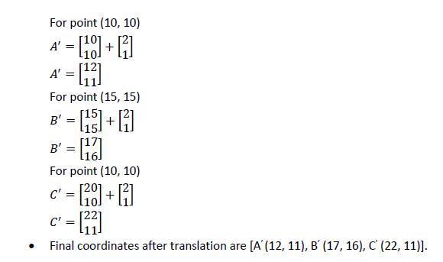

Slide 11
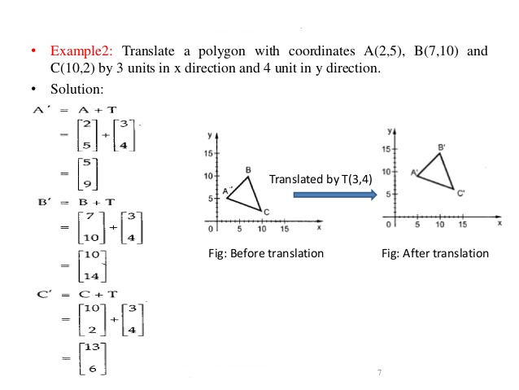

Slide 12
Practical assignment

Slide 13
Practical assignment
Translate a triangle
A(100,150)
B(150,170)
C(200,100)
With 200 units in X-direction and 150 units in Y-direction

